Slide 1
Module 4- Pure Substances Part I

Slide 2
Pure Substance
A substance that has a fixed chemical composition throughout is called a Pure Substance
A pure substance does not have to be of a single chemical element or compound
A mixture of various chemical elements or compounds is a pure substance as long as the mixture is homogeneous, e.g. Air
A mixture of oil and water is not a pure substance as oil is not soluble in water

Slide 3
Pure Substance…
A mixture of two or more phases of a pure substance is still a pure substance as long as the chemical composition of all phases is the same, e.g. Mixture of ice and water
A mixture of liquid air and gaseous air is not pure substance as the compositions are different

Slide 4
Phases of a Pure Substance
A Phase is identified as having a distinct molecular arrangement that is homogeneous throughout and separated from the others by easily identifiable boundary surfaces, e.g. iced water
Substances are present in three phases-Solid, Liquid and Gas (vapour)

Slide 5
Phases of a Pure Substance…
The molecules in a solid are arranged in 3-D pattern
Due to the small distances between the molecules in a solid, the attractive forces of molecules on each other are large and keep the molecules in fixed positions
The molecular spacing in the liquid phase is similar to that in solids except that the molecules are no longer at fixed positions relative to each other and can rotate and translate freely

Slide 6
Phases of a Pure Substance…
In the gas phase, the molecules are far apart from each other and molecular order is nonexistent
Gas molecules move about random, continually colliding with each other and the walls of the container
Molecules in the gas phase are at a considerably higher energy level than they are in the liquid and solid phases

Slide 7
Phase Change Processes
Phase change processes take place in practical situations
Water exists as liquid and vapour in a boiler and a condenser
The refrigerant turns from liquid to vapour in a refrigerator
Here, water is used to explain the process but the principles are equally applicable to other pure substances

Slide 8
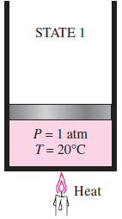
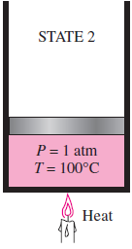
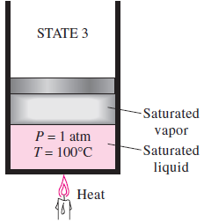
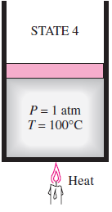
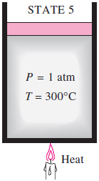
Phase Change Processes in a Pure Substance
State 1: Compressed Liquid
State 2: Saturated Liquid
State 3: Saturated liquid + Vapour
State 4: Saturated Vapour
State 5: Superheated Vapour

Slide 9
Definitions
Compressed or Sub-Cooled liquid means that it is not about to vapourize
Saturated Liquid is a liquid that is about to vapourize
Saturated Vapour is a vapour that is about to condense
Saturated Liquid-Vapour Mixture is a condition where liquid and vapour coexist in equilibrium
Superheated Vapour is a vapour that is not about to condense

Slide 10
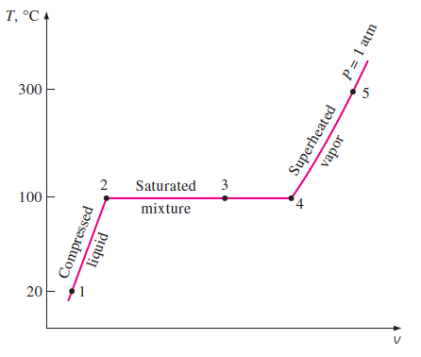
Definitions…

Slide 11
Definitions…
Saturation Temperature (T_{sat}) is the temperature (at a given pressure) at which a pure substance changes phase
Saturation Pressure (P_{sat}) is the pressure (at a given temperature) at which a pure substance changes phase
Latent Heat of Vaporization is the amount of energy absorbed during evaporation

Slide 12
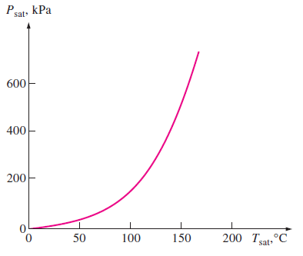
Liquid-Vapour Saturation Curve
T_{sat}=f(P_{sat})

Slide 13
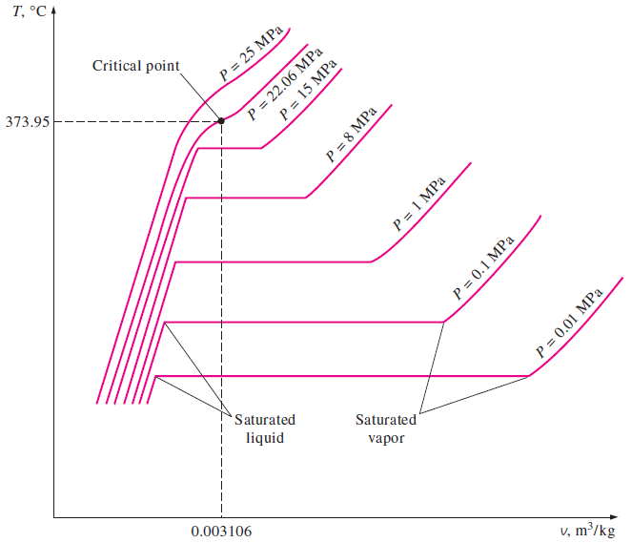
T-V Diagram

Slide 14
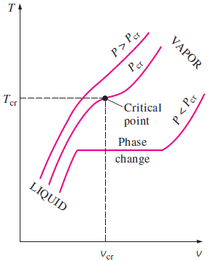
Critical Point
Critical Point is defined as the point at which the saturated liquid and saturated vapour states are identical
For water, P_{cr}=22.06 Mpa
T_{cr}=373.95 ⁰C

Slide 15
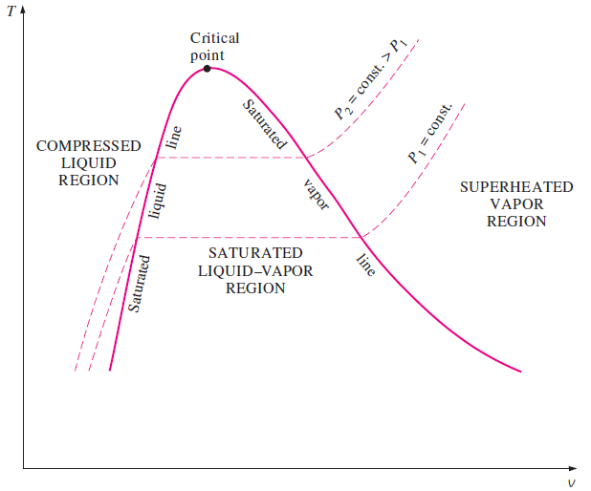
T-V Diagram…

Slide 16
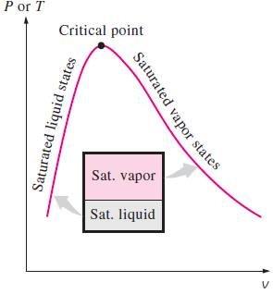
Liquid-Vapour Mixture

Slide 17
Properties of Liquid-Vapour Mixture
F (for fluid) =Liquid
G (for gas) =Vapour

Slide 18
Characteristics of Superheated vapour
Compared to saturated vapour, superheated vapour is characterized by

Slide 19
Characteristics of Compressed Liquid
A compressed liquid is characterized by
However, the properties of compressed liquid are not much different from the corresponding saturation liquid values

